Slide 1
Chapter 22
ensuring network availability

Slide 2
Performance metrics
Device/Chassis
Temperature
Overheating a main cause of reboots
PC usually cools itself with fans but may require additional cooling (liquid)
Dust is a major cause of overheating
CPU
We should use as much of the CPU cycles as possible- you paid for it
However, there is a line you don’t want to cross
CPU over 90% we start having problems
We use counters to monitor the CPU- discussed in chapter 13
Memory
Can be as severe as high CPU utilization and can be an indicator of malware
Can result in the system crashes and /or performance degradation
We can use monitoring tools to monitor the memory utilization and send alarms
Discussed in Chapter 13

Slide 3
Performance metrics/sensors
Network Metrics
Bandwidth
Water of Life for the network
You can never have enough
A great deal of time is spent monitoring and trying to improve bandwidth
Latency
Consistent delay in traffic
Measured in Round Trip Time (RTT)
Jitter
Variance in delay

Slide 4
SNMP
Ports ?
3 Versions
Version 3 should be used. 1 and 2 are unsecure and depricated
Traps
Uses a Network management System to communicate with devices
Uses a GET message to query devices
Devices will send a trap when a problem occurs
Object Identifiers(OIDs)
Standardized mechanism to name objects or things with a globally unambiguous persistent name
In SNMP each node in a management information base (MIB) is identified by an OID
Management Information Bases (MIBs)
An heiarchial structure of OID’s

Slide 5
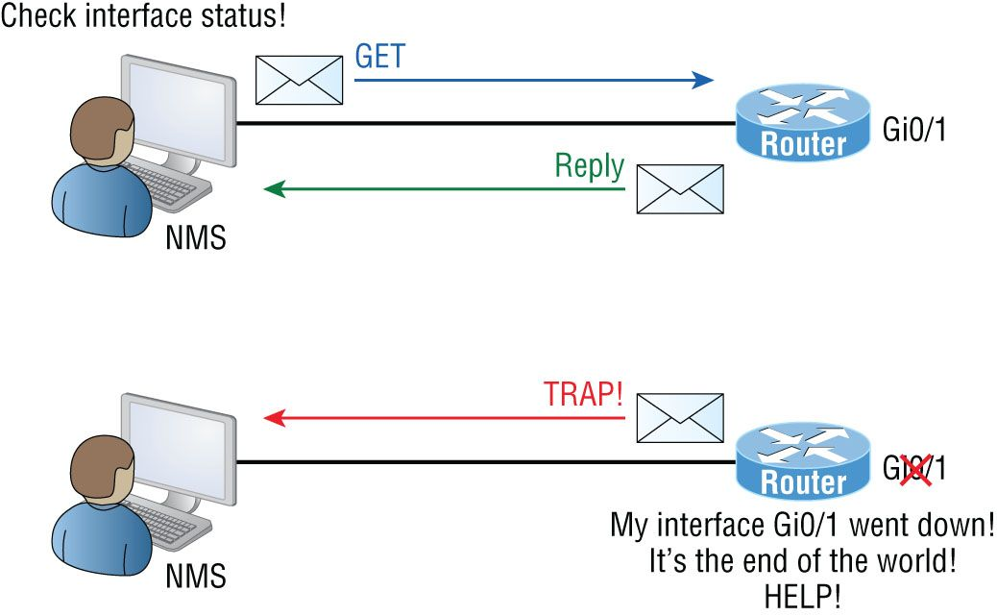
SNMP Traps

Slide 6
Network device logs
Log Review
Traffic Logs
Network Devices
Audit Logs
Windows/linux systems
Syslog
SiEM
Logging Levels/Severity Levels

Slide 7
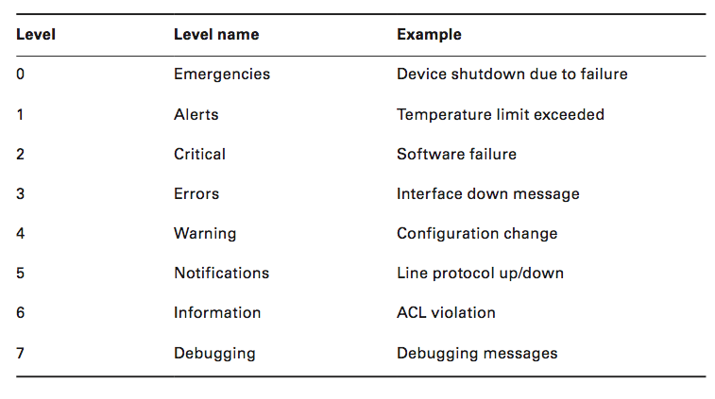
Cisco Log Levels

Slide 8
Interface Statistics/status
Link State
Is it up or down
First ting to check if we get a link error
Speed/Duplex
Both ends should match
Run the ‘ show running configuration command’ (sh run) to check interfaces on routers and switches
Usually set to Auto
Send/Receive Traffic
To check on interface you would run ‘ sh int <int>’
Cyclic Redundancy Checks (CRCs)
Error detection mechanism
Protocol Packet and Byte counts
To check you would run ‘sh int <int>

Slide 9
Interface Errors or Alerts
CRC Errors
Damaged packet
Bad port, bad cable, duplex mismatch, etc
Giants
Packets that exceed the maximum packet size and/or incorrect frame check sequence
Usually discarded
Caused by a bad NIC
Runts
Packets that do not meet minimum packet size
Usually discarded
Caused by bad NIC
Encapsulation Errors
Missing header from OSI layer
Example- layer 3 missing layer 2 information. Cant forward

Slide 10
Environmental factors and sensors
Temperature
Humidity
Electrical
UPS
Multiple Circuits
Flooding
Severs/datacenters on upper floors or raised floors

Slide 11
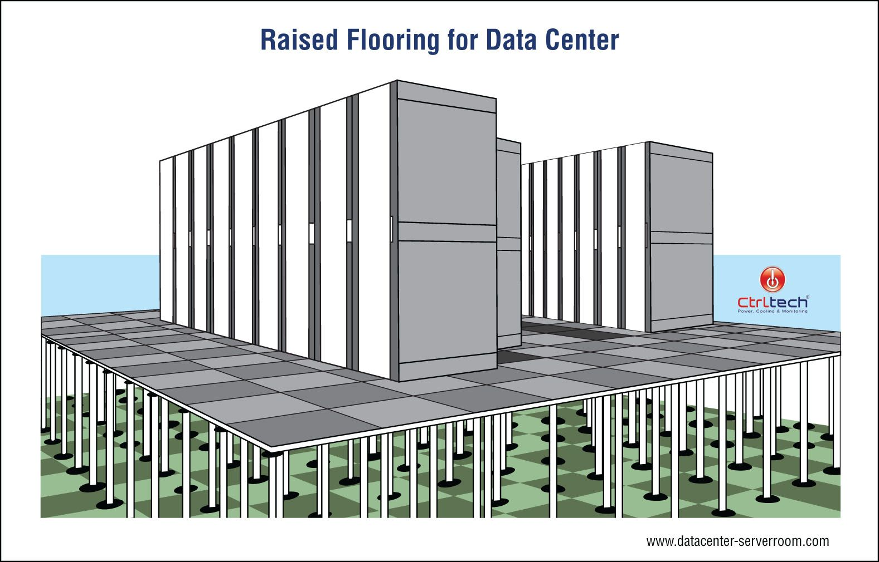

Slide 12
Misc
Baselines
Netflow data
Uptime/downtime
99.99
99.999

